Slide 1
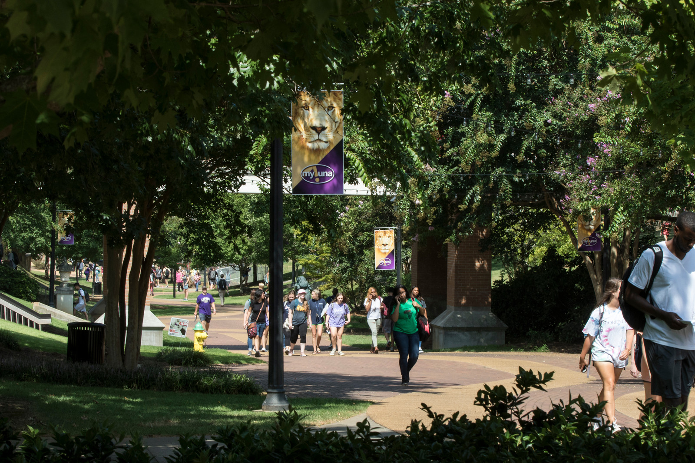
CAMPUS CLIMATE DIVERSITY STUDY
2018 REPORT

Slide 2
ROAD MAP
Commission of Study
Research Design
Preview Findings
Faculty & Staff Survey Results
Student Survey Results
Recommendations
Discussion

Slide 3
COMMISION OF STUDY
Fall 2017, this study was commissioned by the Office of Academic Affairs and was comprised of members from various colleges and departments
Purpose:
This survey was conducted to provide UNA with critical information regarding our campus climate, campus resources, and experiences of our students, faculty, and staff

Slide 4
RESEARCH DESIGN
The committee used a multi-method design including Qualtrics survey and focus group questions
Survey launched February 5 – closed April 2, 2018
Three focus groups conducted spring 2018 semester (February 27, March1, and March 6)
 | Total contacted | Responses received | Participation rate
Faculty | 371 | 104 | 28%
Staff | 539 | 109 | 20%
 | Completed some portion | Participation rate
Students | 712 | 10%
 | Provided demographic data | Participation rate
Students | 479 | 7%

Slide 5
PREVIEW FINDINGS
2018 REPORT – CAMPUS CLIMATE SURVEY

Slide 6
FACULTY & STAFF SURVEY RESULTS

Slide 7
FACULTY & STAFF OVERALL EXPERIENCES
88.3% report excellent or good overall experience
89.1% are very satisfied or satisfied with their overall work experience
80% agree that it is extremely or very important that UNA hold diversity as one of its essential values
73% have integrated diversity topics into their course material (e.g., examples from a global perspective, scholarship by authors from diverse populations)

Slide 8
BELIEFS ABOUT DIVERSITY
Table 1. Faculty/Staff Beliefs about Diversity at UNA (n=199)
Measures | Strongly Agree/Agree
Good job of implementing diversity policies | 61.8%
Expectations for respect are clearly articulated | 76.9%
Safe environment to raise concerns of diversity | 65.8%
Message from campus leaders is consistent | 69.8%
Environment for free expression | 65.3%
Distinguish b/t free speech and hate speech | 53.3%
Committed to success of minority students | 67.8%
Easy to find diversity information on UNA website | 44.7%
UNA tries to diversify applicant pools | 54.5%
Too much emphasis on diversity | 15.1%
Admitting less qualified students | 12.6%
Hiring less qualified employees | 13.6%
Diversity topics detract from other knowledge | 14.1%

Slide 9
BELIEFS & EXPERIENCES WITH EMPLOYMENT-BASED DISCRIMINATION

Slide 10
STUDENT SURVEY RESULTS

Slide 11
STUDENT SURVEY RESULTS, Cont.

Slide 12
STUDENTS Overall EXPERIENCE
87.9% rate their overall experience as good or excellent
88.3% are satisfied or very satisfied with academic experience
66.8% are satisfied or very satisfied with social experience
76.3% indicated that it is extremely or very important that UNA holds diversity as one of its essential values

Slide 13
STUDENT EXPERIENCES IN THE CLASSROOM
Table 3. Student Experiences in the Classroom at UNA (n=578)
Measures | Strongly Agree/Agree
Professors make students welcome | 86.7%
Feel comfortable with students in class | 77.9%
Singled out in class | 12.8%
Intolerance in class because of students | 14.9%
Intolerance in class because of instructor | 13.8%
Stereotyped by instructor | 11.4%
Stereotyped by students | 21.1%
Inappropriate comments about my appearance | 7.4%

Slide 14
REASONS PREVENTING INTERACTION WITH OTHERS FROM DIVERSE BACKGROUNDS
Table 4. Reasons Preventing Interactions with Others from Diverse Backgrounds (n=542)
Measures
Conflicting feelings about different cultures | 28.0%
Worry people won’t understand what I’m saying | 34.5%
Uncertainty about what to say | 41.7%
Fear of appearing insensitive or ignorant | 42.6%
Prefer to interact with people like me | 37.3%
Lack of opportunity | 50.0%

Slide 15
STUDENT BELIEFS ABOUT DIVERSITY
Table 5. Student Beliefs about Diversity at UNA (n=494)
Measures | Strongly Agree/Agree
Good job of implementing diversity policies | 75.1%
Expectations for respect are clearly articulated | 82.2%
Safe environment to raise concerns of diversity | 76.3%
Message from campus leaders is consistent | 76.9%
Environment for free expression | 78.9%
Distinguish b/t free speech and hate speech | 65.4%
Committed to success of minority students | 70.0%
Easy to find diversity information on UNA website | 53.6%
Too much emphasis on diversity | 28.7%
Leads to admitting less qualified students | 27.9%
Leads to hiring less qualified employees | 21.3%
Diversity topics detract from other knowledge | 39.9%

Slide 16
Faculty/staff & student comparisons
Table 7. Respect for Different Groups on Campus (excellent or good)
Measures | Student Responses (n=501-511) | Faculty/Staff Responses (n=205-217)
Faculty respect for racial/ethnic minority students | 85.7% | 83.4%
Faculty respect for female students | 85.9% | 86.6%
Faculty respect for transgender students | 75.2% | 61.2%
Student respect for racial/ethnic minority faculty | 81.6% | 77.2%
Student respect for female faculty | 83.3% | 77.3%
Student respect for racial/ethnic minority students | 76.5% | 68.4%
Student respect for sexual minority students | 68.1% | 53.8%
Student respect for transgender students | 56.9% | 40.5%

Slide 17
FOCUS GROUPS
Table 9. Demographics for Focus Groups
Focus Group 1 (n=5) | Focus Group 2 (n=7) | Focus Group 3 (n=6)
Women = 5, Men = 0 | Women = 5, Men = 2 | Women = 3, Men = 3
Heterosexual = 4 Bisexual = 1 | Heterosexual = 6 Bisexual = 1 | Heterosexual = 4 Bisexual = 1 Gay = 1
African American = 4 White = 1 | African American = 3 Asian = 1 Hispanic = 1 White = 2 | African American = 4 Multiracial = 2
Mean Age = 20.6 Range = 19-23 | Mean Age = 19 Range = 18-21 | Mean Age = 21 Range = 19-23
Christian = 5 | Christian = 6 Atheist = 1 | Christian = 4 Prefer not to answer = 2

Slide 18
RECOMMENDATIONS
Training:
Require face-to-face diversity training for students, faculty, and staff
Train professionals (other than Title IX and student conduct) to discuss diversity issues with students
Provide training to SOAR counselors/RA’s
Communication:
Conduct University sponsored panel discussions about diversity
Offer open mic nights for students to discuss diversity
Promote classroom conversations about diversity by including this on faculty teaching evaluations
Conduct small group discussions for students of various topics related to diversity
Offer students more of a voice regarding diversity on campus by polling students more often and using social media more effectively to increase awareness of diversity on campus

Slide 19
RECOMMENDATIONS, cont.
Curriculum:
Develop a Common Read program and choose a book that focuses on diversity related issues for students to read their first semester
Encourage faculty to develop more educational opportunities and class activities related to diversity in their courses
Support scholarship and experiential learning strategies that work to improve diversity and inclusion both on campus and in the Shoals community
Develop an African-American/Black Studies program
Provide more advertising for our existing programs in Women’s Studies, Global Studies, Asian Studies, and Latin American Studies

Slide 20
RECOMMENDATIONS, cont.
Policy:
Design new policies that contribute to an inclusive campus environment that reflect the University approved definition of diversity
Strengthen existing policies regarding discrimination on campus to establish a transparent process for conduct issues, which will ensure equitable treatment and accountability for all students. Students need to be familiar with the role of the Ombudsman in the grievance process or create additional contact outside the conduct office for students who feel they have received inequitable treatment in the conduct process
Clarify and articulate the parameters of religion on campus. UNA should also model these set parameters by refraining from endorsing any religion during university-sponsored events (e.g., convocation, graduation, award ceremonies, etc.)
Create University-supported Safe Zone training and promote LGBTQ equality
Explore options of themed housing with Residence Life to increase student sense of belonging
Ensure that all classes are accessible for students with disabilities and that campus buildings are ADA compliant
Develop a policy to distinguish and clarify the difference between free speech and hate speech
Develop transparent hiring, promotion, and reappointment processes and utilize them

Slide 21
Benchmarks for ACADEMIC YEAR 2018-19
Here are a few measurable, realistic, implementable goals:
Welcome the first President’s Diversity Faculty Fellow in Fall 2018 & Recruit second Fellow to begin Fall 2019
Establish a “common book” or “common reader” program focused on diversity and inclusion, with Fall 2019 implementation in all FYE courses (across 35 sections) and 10 to 15 campus events, including Residence Halls
Formal proposal and implementation of an African American/Black Studies major or minor (Fall 2019 launch)
Implementation of 11 recommendations from the Campus Climate Diversity Study
Develop and implement a Center for Social Inclusion

Slide 22
Resources
For results of the Campus Climate Survey 2018 Report, visit
For update progress towards the Strategic Diversity and Inclusion Plan, (link to website)
To access the Diversity Statement, visit https://www.una.edu/diversity/
For information about Diversity and Institutional Equity, visit https://www.una.edu/diversity/
For information about Title IX, visit https://www.una.edu/titleix/
To access additional baseline data, visit (link to website)

Slide 23
DISCUSSION

